Slide 1

Progress report

Slide 2

Project Overview
We have managed to employ permanent staff.
Employee reimbursement however has become a hurdle.
The system earlier set was suitable for temporary employment.
raising concerns over inequity of reimbursement, late payments, inconsistent system of payment and insurance coverage.

Slide 3

Project Goals
We have set is to create a dependable hiring, assigning and human resource management system.
It is important that we take care of our employees.
The system will assign roles to each occupation, the wage level of each occupation, the appraisal standards, the relation of each occupation to other occupation and the benefits received.

Slide 4

Project Approach
I have set aside particular group tasked to come up with the system with the help of a newly employed human resource manager in supervision.

Slide 5
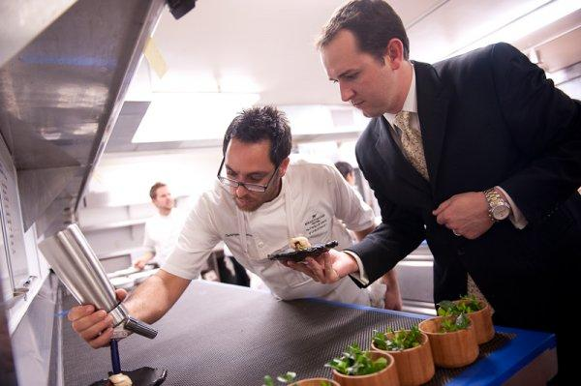
Expected results
The changes effected in the restaurant organizational culture and in the human management system will make the restaurant even more profitable

Slide 6

Resources
Capital is relatively inadequate.
The human capital required is insourced therefore not costly.
The stationary and many other materials used in the research and development
will be covered in the kitty account.

Slide 7
Assumption
The need and requirement for employment will remain constant in the market under the legal and forces of economy.
The employees will remain in service in the restaurant during the period of the development of the system.

Slide 8

Milestone
Sales throughout other days of the week are to increase probably within the first month of relative changes and overall sales to be realized with profits later.

Slide 9
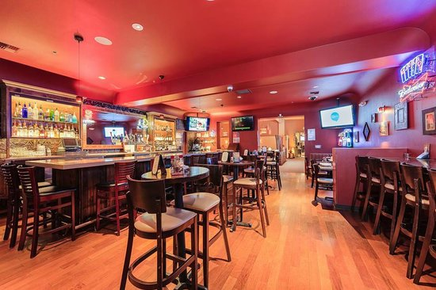
Limits and Exclusions
Capital limits due to little profit margins.
With time a lot of profits will be realized as I incorporate other stakeholders.

Slide 10
Reference
Walker, J. R. (2013). The restaurant: from concept to operation. Wiley Global Education.
Han, H., & Hyun, S. S. (2017). Impact of hotel-restaurant image and quality of physical-environment, service, and food on satisfaction and intention. International Journal of Hospitality Management, 63, 82-92.
Giousmpasoglou, C. (2016). Hotel and restaurant management education.
Zheng, C., & Forgacs, G. (2017). The emerging trend of hotel total revenue management. Journal of Revenue and Pricing Management, 16(3), 238-245.
Ruiz-Molina, M. E., Gil-Saura, I., & Berenguer-Contrí, G. (2014). Information and communication technology as a differentiation tool in restaurants. Journal of Foodservice Business Research, 17(5), 410-428.
Silva, J. (2017). U.S. Patent No. 9,805,401. Washington, DC: U.S. Patent and Trademark Office.

